Slide 1

SmartLibraryApplication
Client - Greenfield Public Library
Submitted by
Meghana G S
Jeevan Sai Javvaji
Vedika Panchamahalkar
Chinnapareddy Yakkanti
Priyanka Yerumsetty

Slide 2

Agenda
Project Introduction
Business Problem & Need for Automation
Project Goals & Benefits
System Features & Functionality
Feasibility & Cost Analysis
Project Timeline & Execution Plan
Conclusion

Slide 3
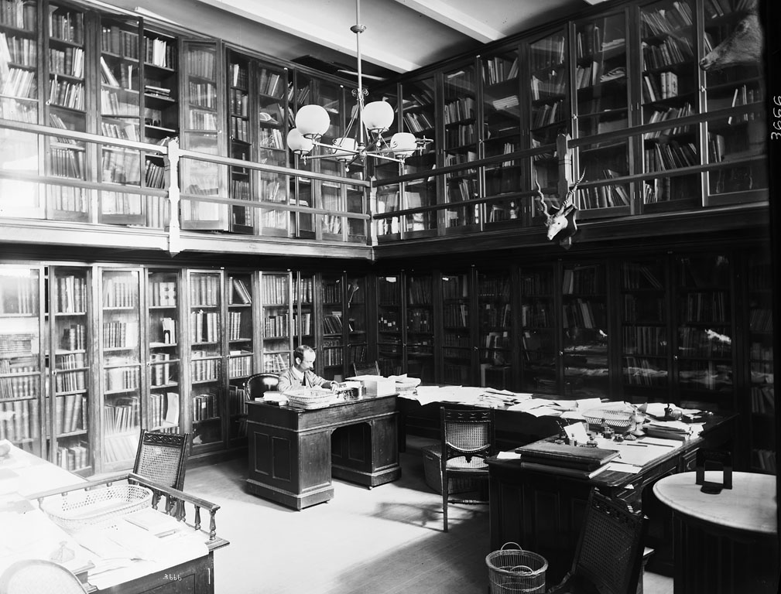
Challenges in Current Library Operations
Manual book tracking leads to inefficiencies.
Request approval process is slow, impacting user experience.
Limited reporting capabilities make decision-making harder.
No automated alerts or notifications for borrowed books.

Slide 4

Project Goals & Benefits
How Smart Library Solves These Issues
Streamlined book borrowing & returns through automation.
Request approval & rejection system for better control.
Data export functionality for enhanced decision-making.
Secure authentication system for admins & users.

Slide 5
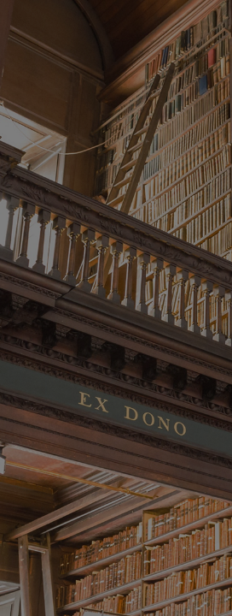
System Features & Functionality
Admin Features:
Book Catalog Management: Add, remove, and update book records.
User Management: Assign roles for students, faculty, and public users.
Borrow & Return Management: Monitor book transactions and statuses.
Request Approval: Accept or reject book borrowing requests.
Report Generation & Data Export: Analyze borrowing trends.

Slide 6
System Features & Functionality
User Features:
Search & Browse Books: Look up books by title, author, or category.
Book Borrowing & Return: Request books & track due dates.
Account Management: View borrowed books & request approvals.
Logout Functionality: Securely log out from the system

Slide 7

Feasibility & Cost Analysis
Estimated Budget: $13,000
Breakdown:
Software Development: $5,000
Database Setup: $2,000
Hosting & Infrastructure: $1,500
Testing & QA: $1,000
Training & Deployment: $1,500
Maintenance (6 months): $2,000
ROI: Increased efficiency, optimized resource management, and reduced admin workload.

Slide 8
Phase 1 (2 Weeks): Requirement gathering & system design. Phase 2 (4 Weeks): Software development & database setup. Phase 3 (2 Weeks): Testing & debugging. Phase 4 (2 Weeks): Deployment & staff training. Total Duration: 10 weeks.
Project Timeline & Execution Plan
”

Slide 9

Conclusion
Smart Library Application improves efficiency & accuracy.
Cost-effective, scalable, and easy to implement in the library.
Approval required for project initiation & execution.
Next Steps:
Obtain stakeholder buy-in.
Initiate development phase.
Periodic progress reviews.

Slide 10

Thank You

